Slide 1
Analyzing British Airways Customer Feedback
Unveiling the Wings of Customer Satisfaction: A Deep Dive into British Airways Customer Feedback

Slide 2
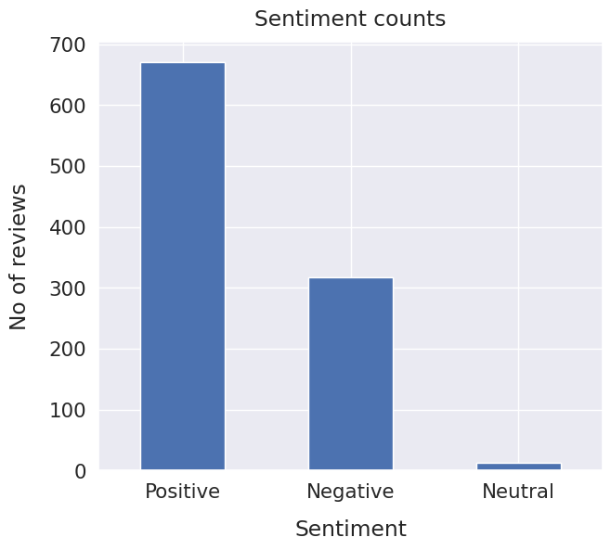
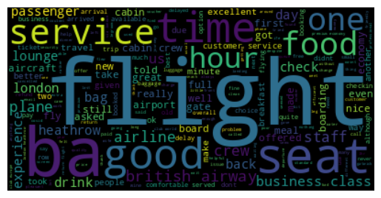
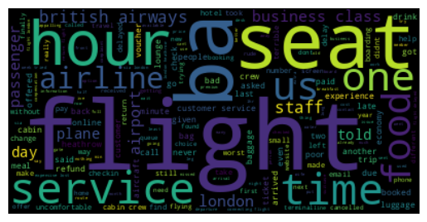
RESULTS
Sentiment
Out of 1000, 670 were positive, 317 were negative and 13 were neutral. By this analysis we can say that most of the reviews are polarized as positive and few are negative.
Visualizing Positive/Negative Customer Feedback: Word Cloud Analysis
To gain a deeper understanding of the positive/negative sentiments expressed by customers, a word cloud was generated based on their feedback.
The word cloud provides a visual representation of the most frequently occurring words, highlighting the key themes and positive/negative aspects highlighted by customers. The larger the word appears in the cloud, the more frequently it was mentioned in the reviews, offering valuable insights into the positive experiences shared by British Airways customers and to gain insights from negative customer feedback highlighting the key issues and concerns expressed by customers.
Positive
Negative

